Slide 1
Lab 1
User Defined Modules

Slide 2
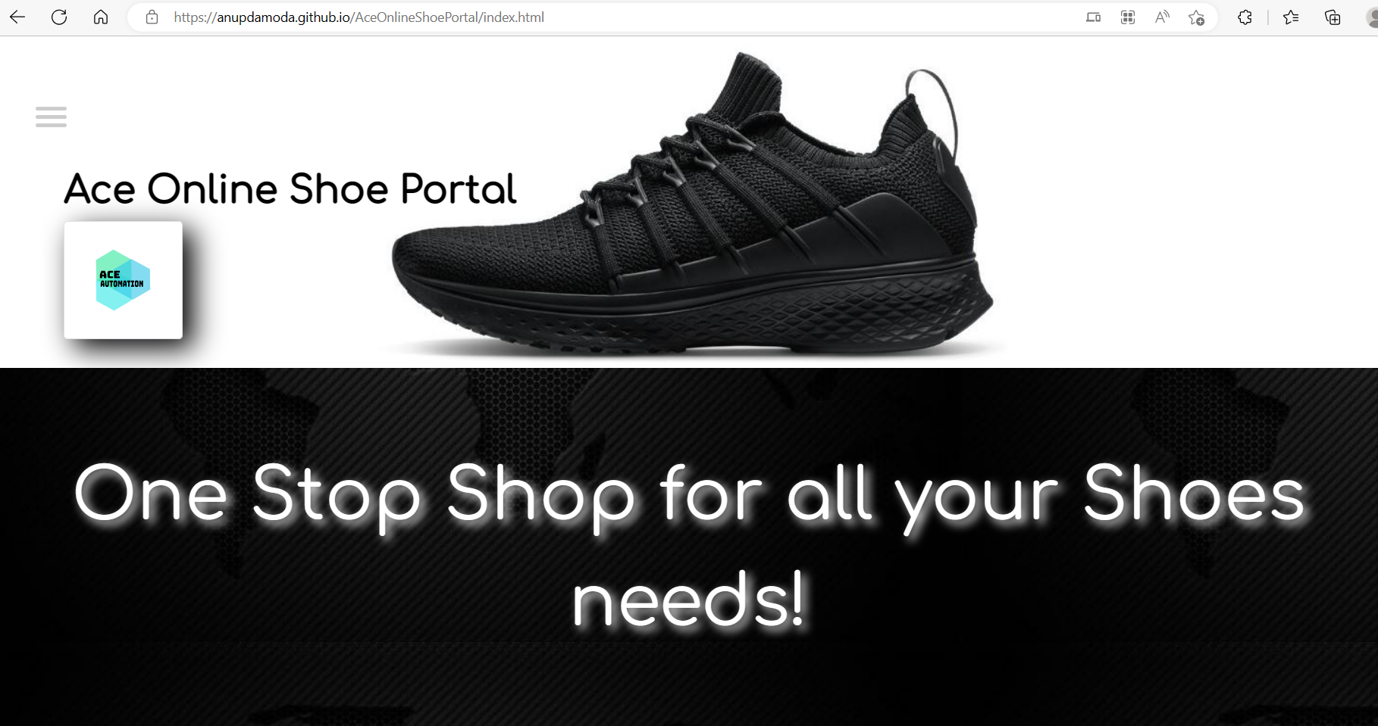
Application Under Test
Ace Online Shoe Portal (anupdamoda.github.io)

Slide 3
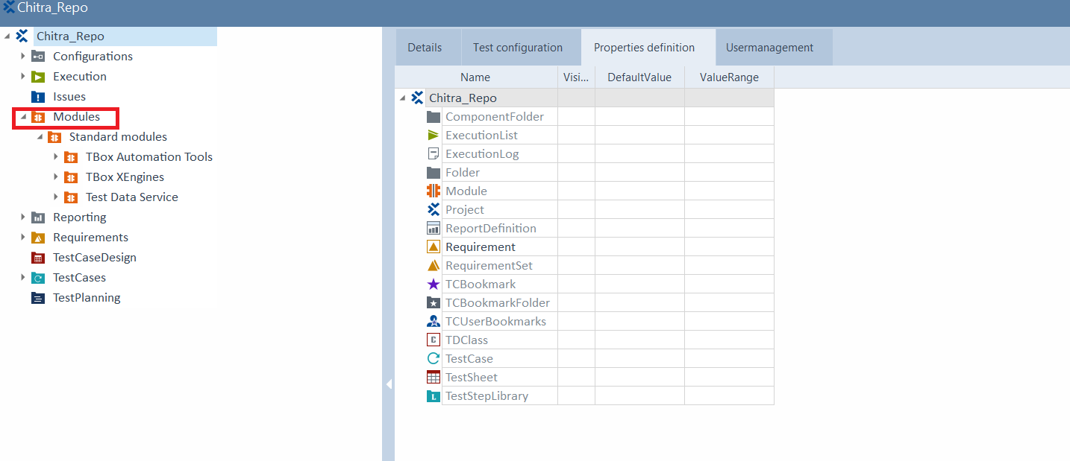
TOSCA Commander and Workspace

Slide 4
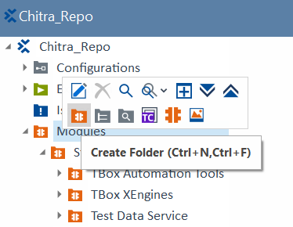
Create a User Defined Module Folder
Right Click on Modules → Create (Standard Module)Folder

Slide 5
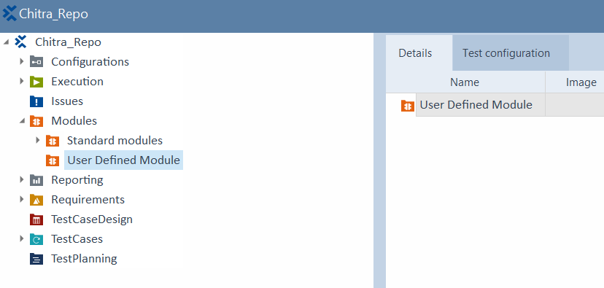
User Defined Module Folder created

Slide 6
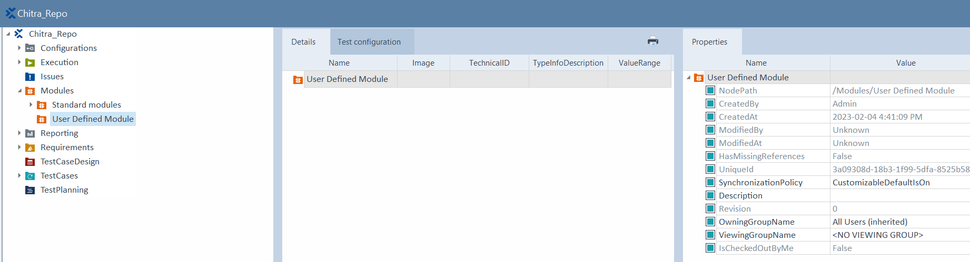
View Properties of User Defined Module Folder

Slide 7
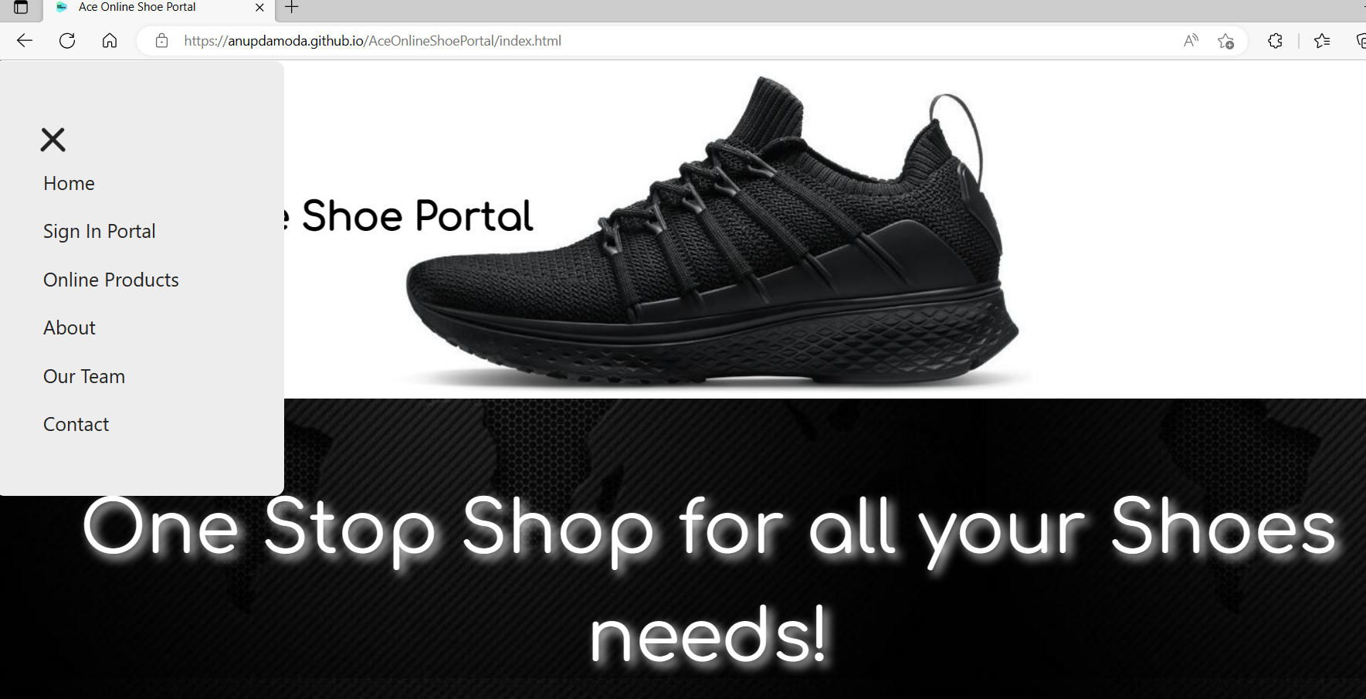
Scan the Application
Open the Application. Click on the hamburger icon to display the menu.

Slide 8
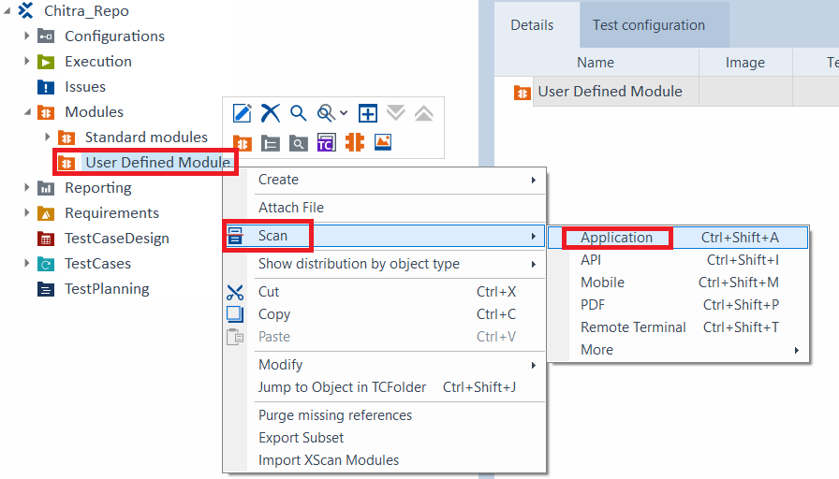
Scan the Application
Right Click on User Defined Module in TOSCA and select Scan Application

Slide 9
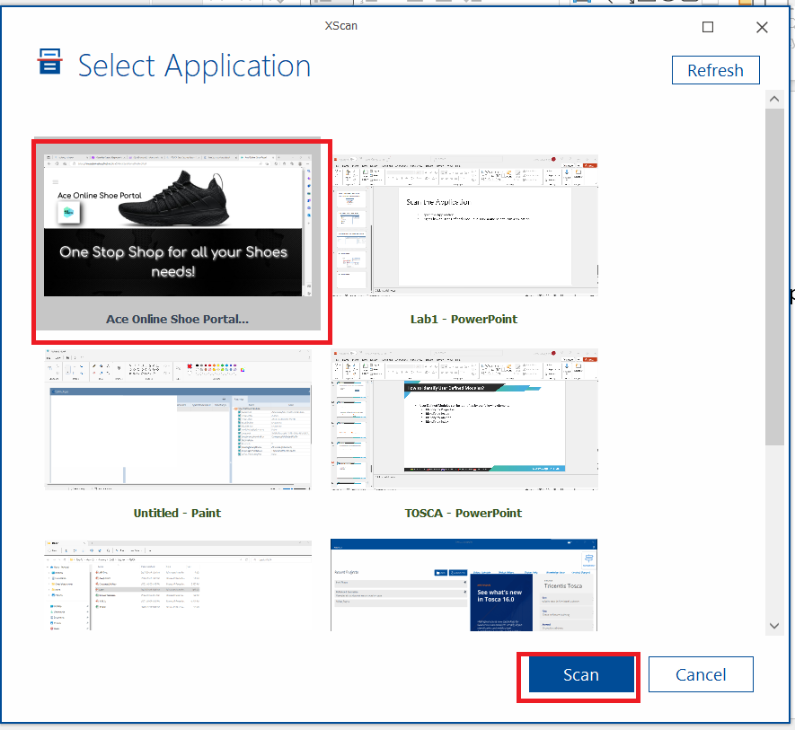
Select the Application

Slide 10
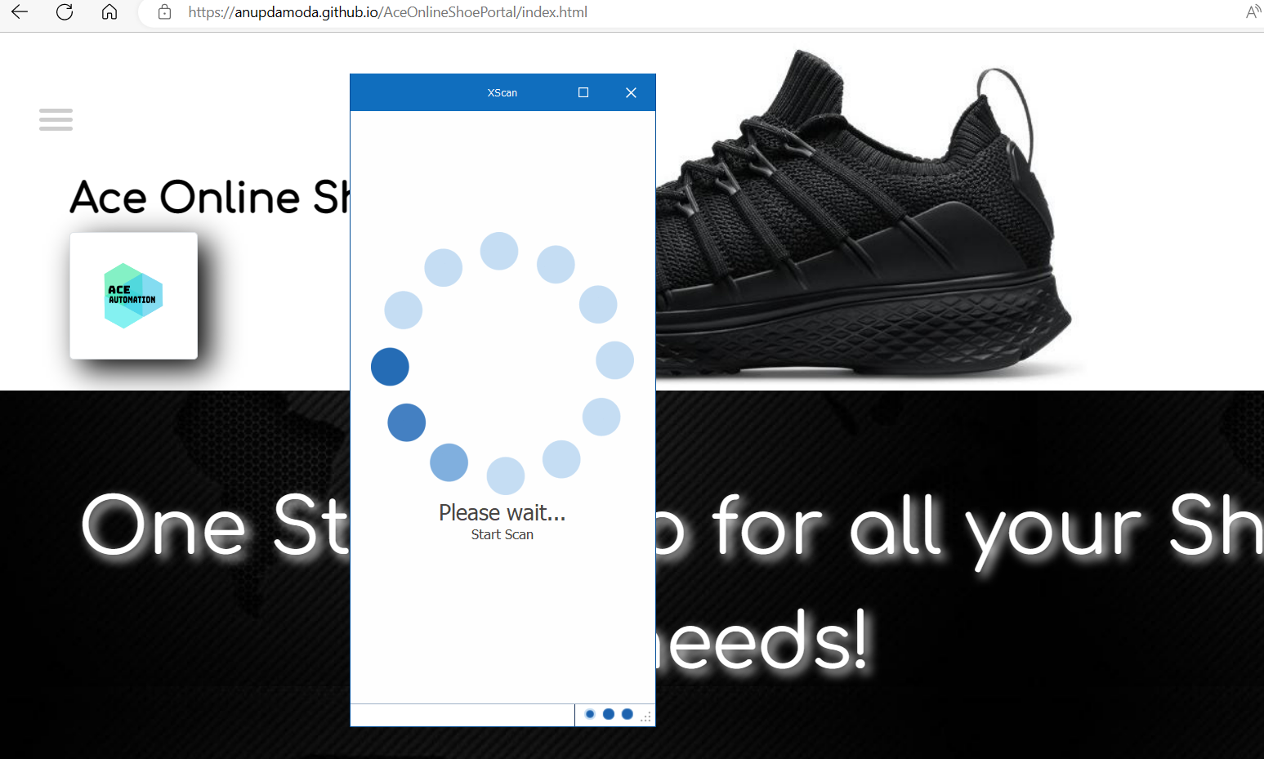
XScan window opens

Slide 11
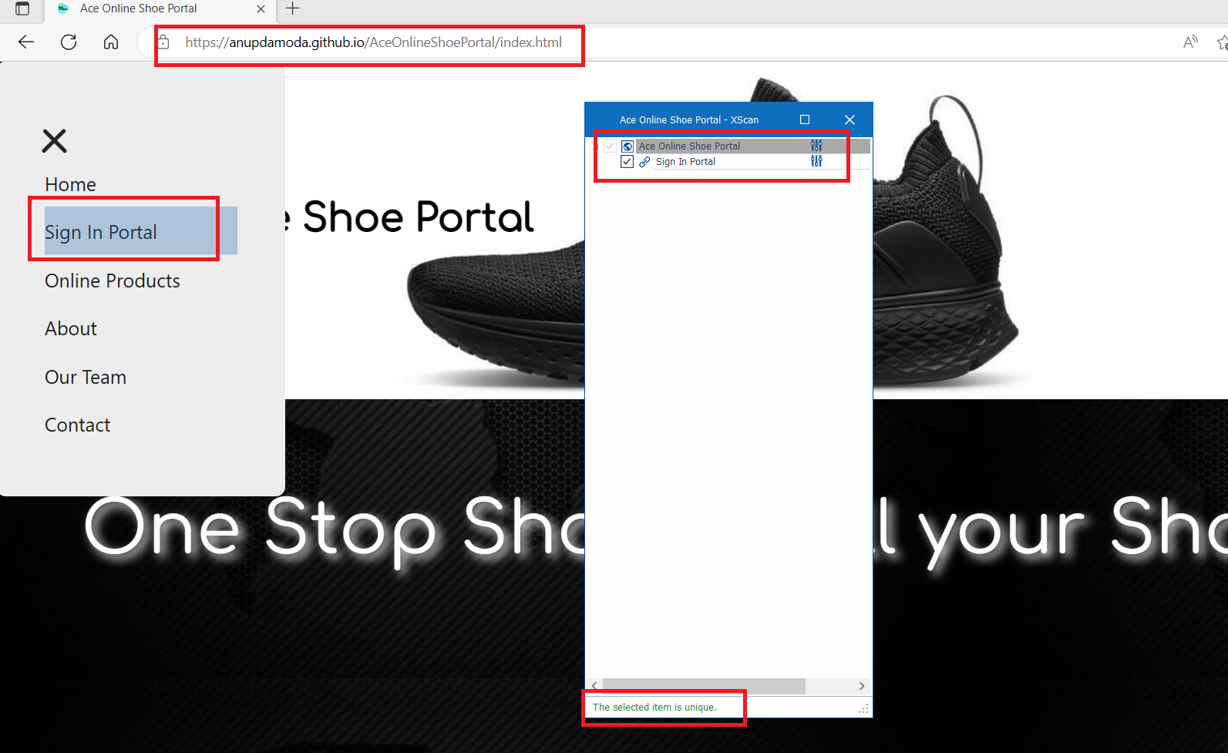
XScan window opens
Click on the Menu and Sig-in Portal.
Observe that the Technical property for the test object is green and says it is unique.

Slide 12
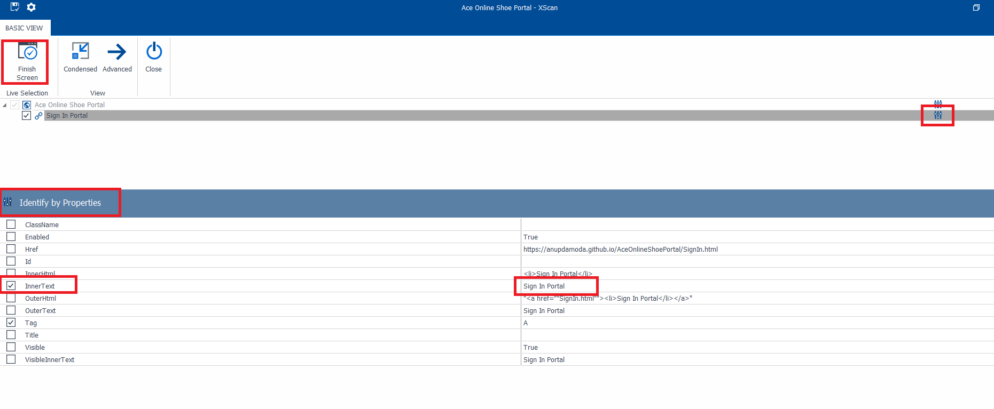
XScan window
View Properties.
Click Close.

Slide 13
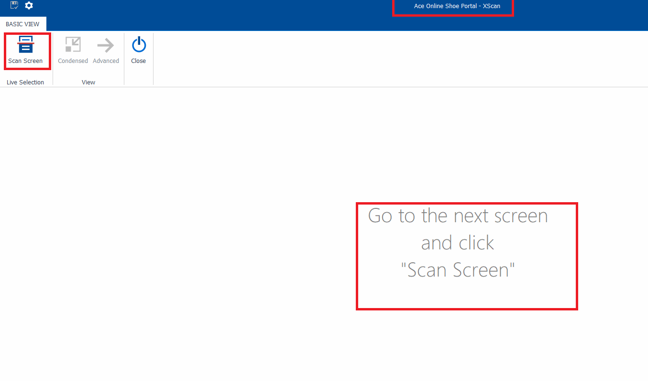
Close XScan window
The Xscan is ready for next. Close it.

Slide 14
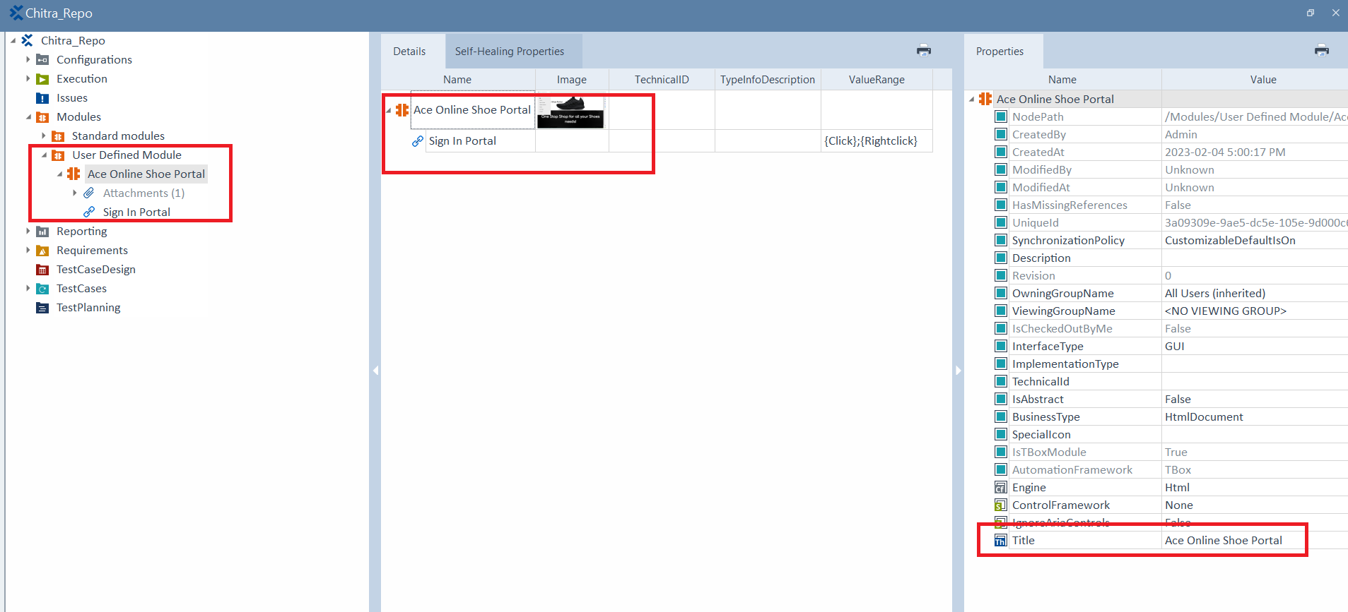
Verify the Module
Go to TOSCA Modules
Observe the new User Defined Module created.

Slide 15
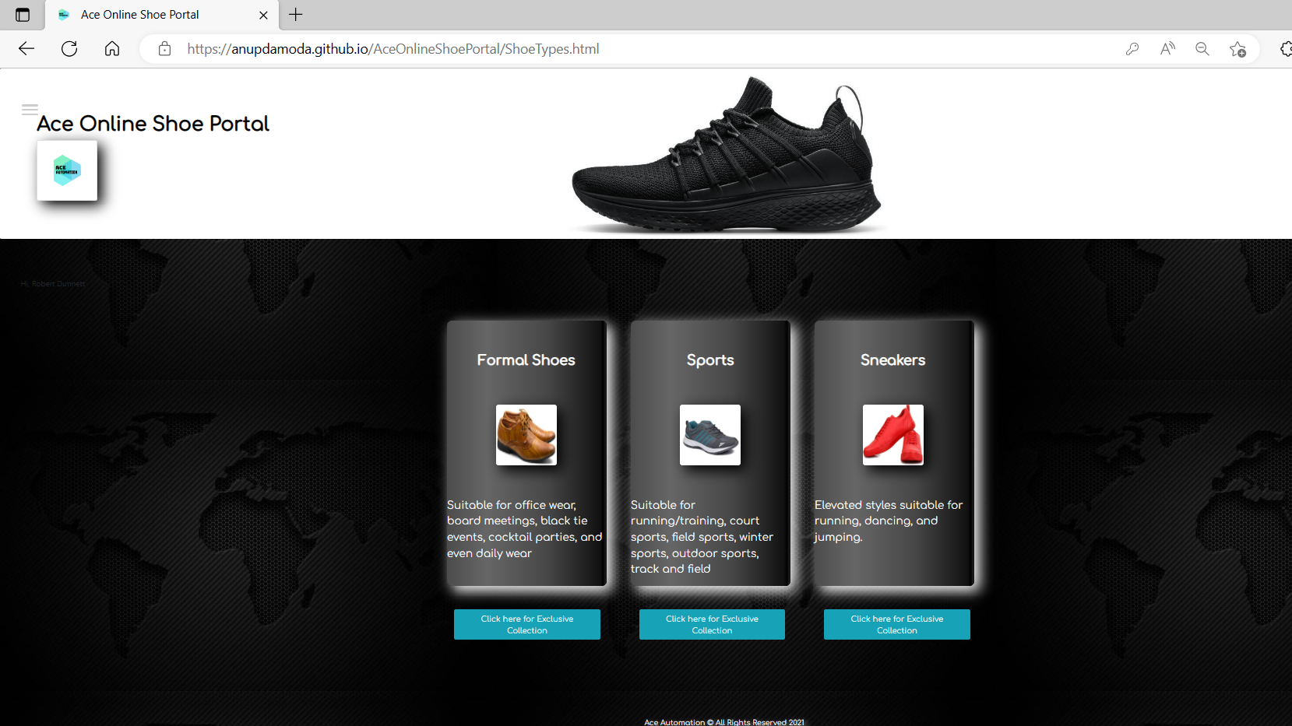
Log in - Identify by Anchor
Login to the application using tlisbon/tlisbon

Slide 16
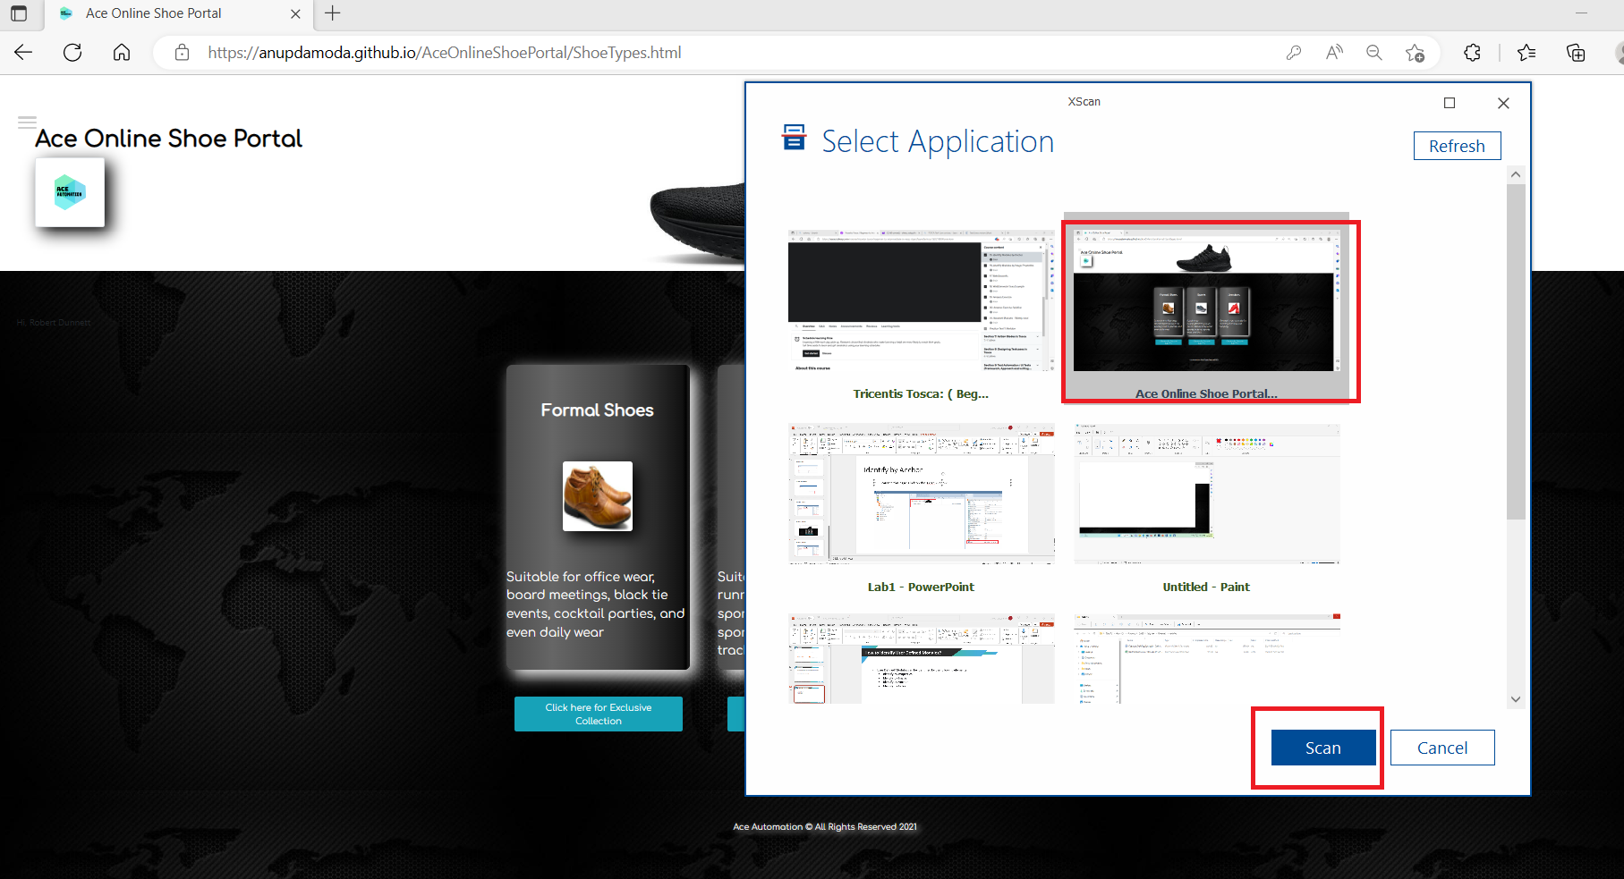
Scan - Identify by Anchor
Scan the this page. Same as above steps.

Slide 17
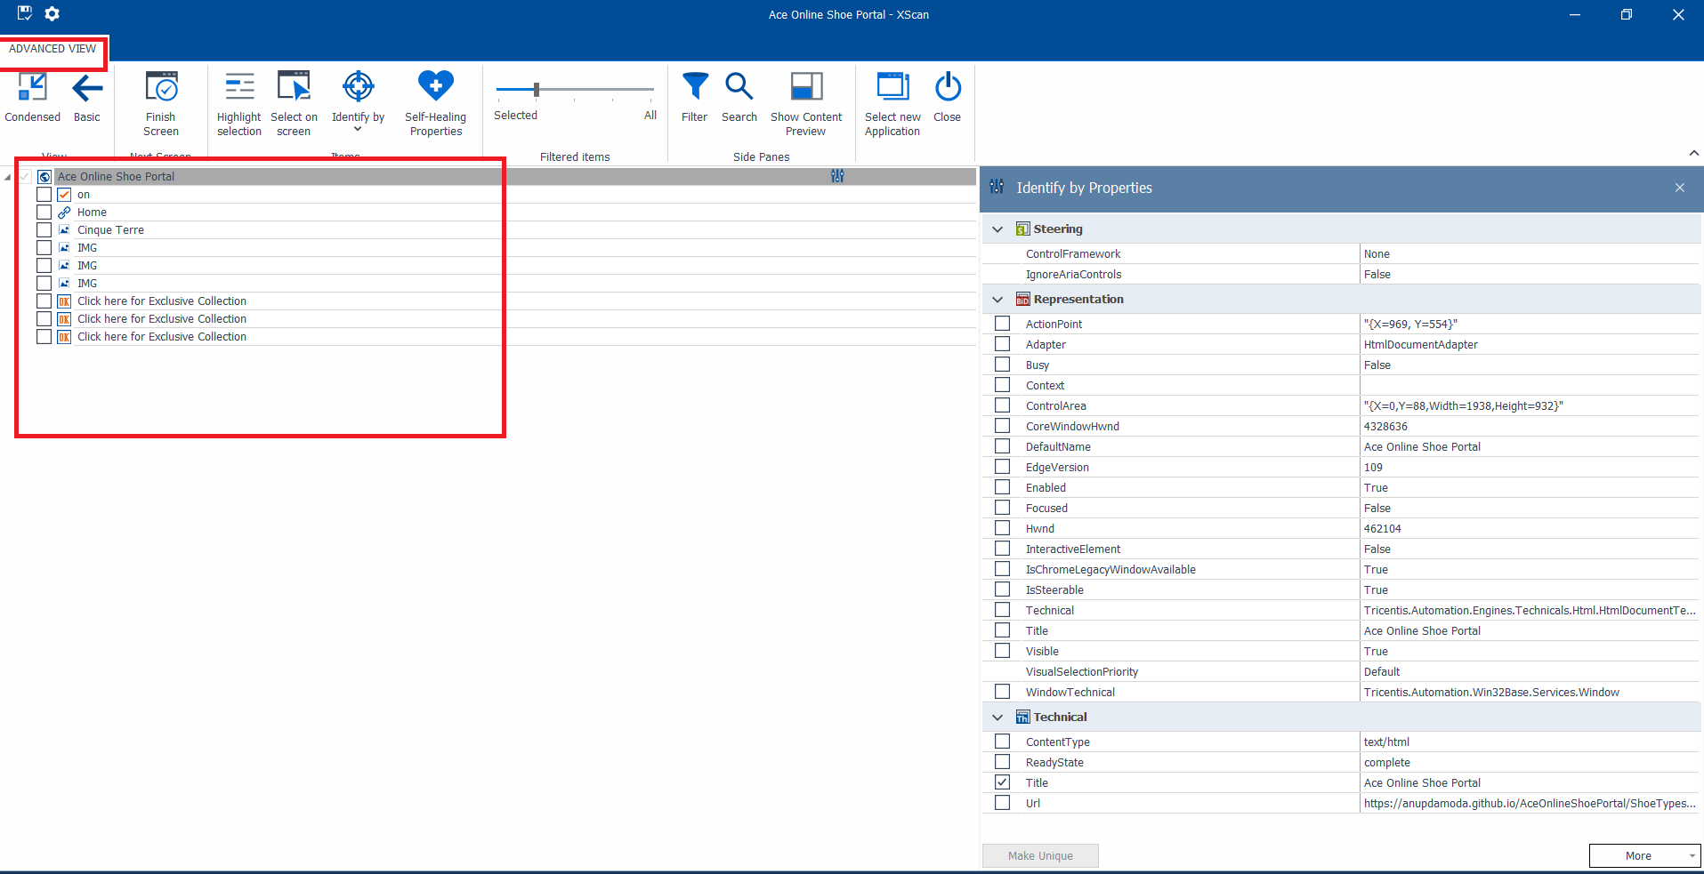
Advanced View - Identify by Anchor
Click on Advanced on Xscan.

Slide 18
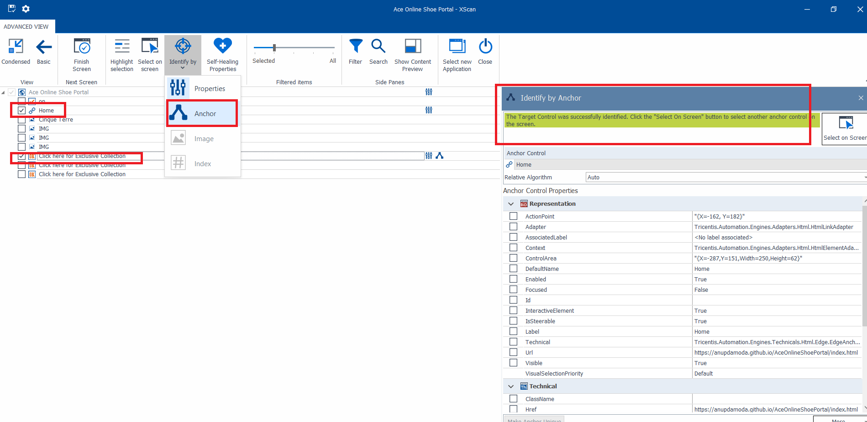
No Unique items - Identify by Anchor
Select the “Click here for Exclusive Collection” button. It is not unique.
Select “Home” item (Parent element)

Slide 19
Result - Identify by Anchor
Select the Identify by Anchor.
Drag and Drop “Home” to the right box. Green message appears that button is unique.

Slide 20
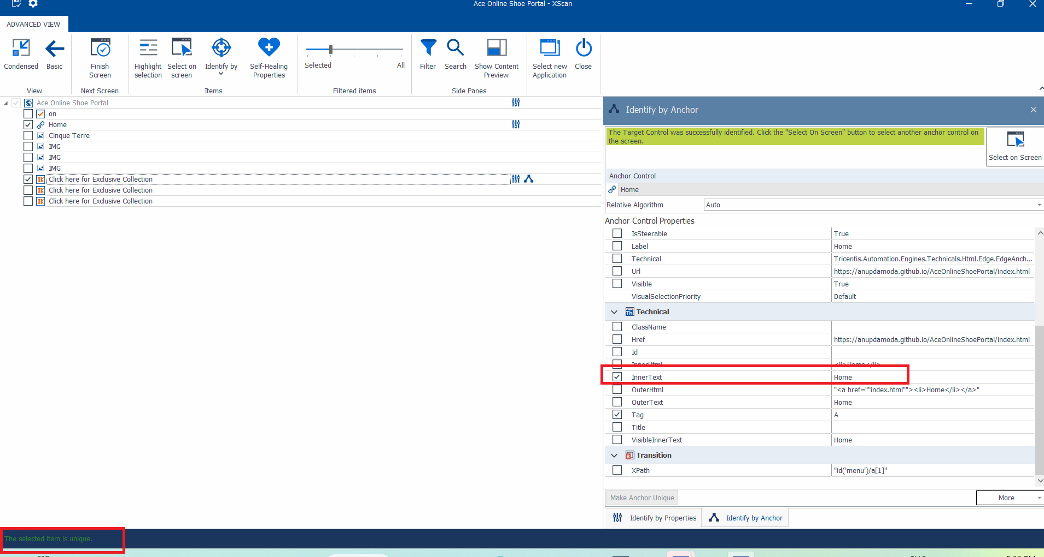
Result - Identify by Anchor
Click Finish Screen.

Slide 21
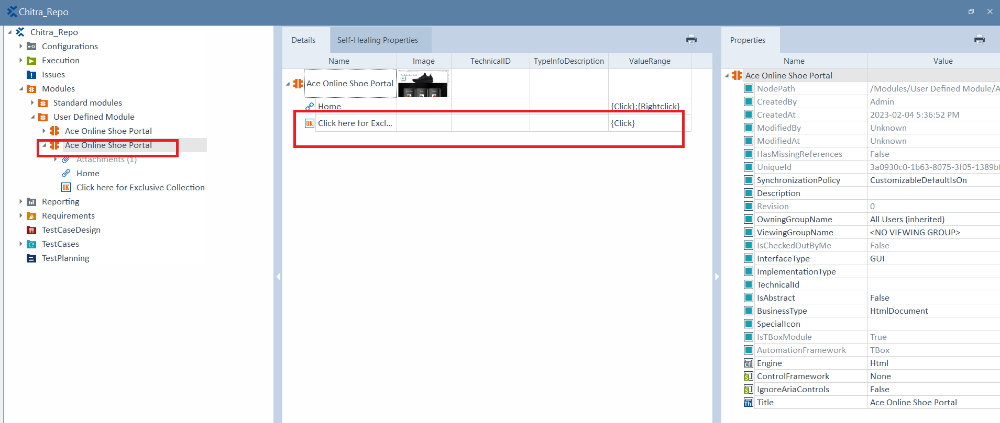
Result - Identify by Anchor
New Module is created.

Slide 22
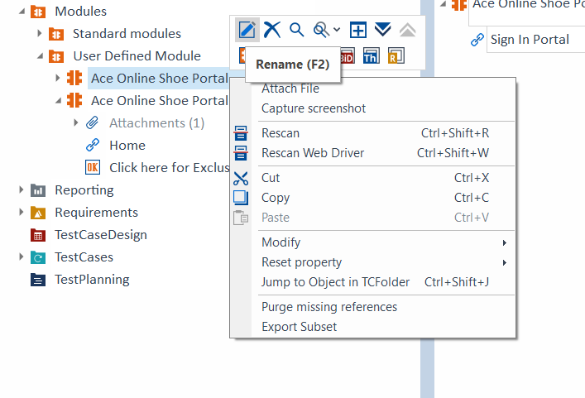
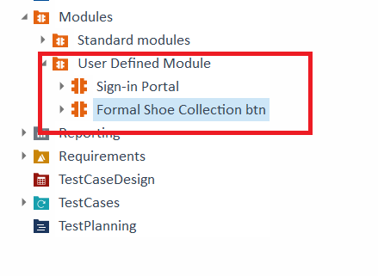
Rename the 2 User Defined Modules
Right Click on Module → Rename icon

Slide 23
Identify by Image
Open the application

Slide 24
Identify by Image
Scan the application

Slide 25
Advanced View - Identify by Image

Slide 26
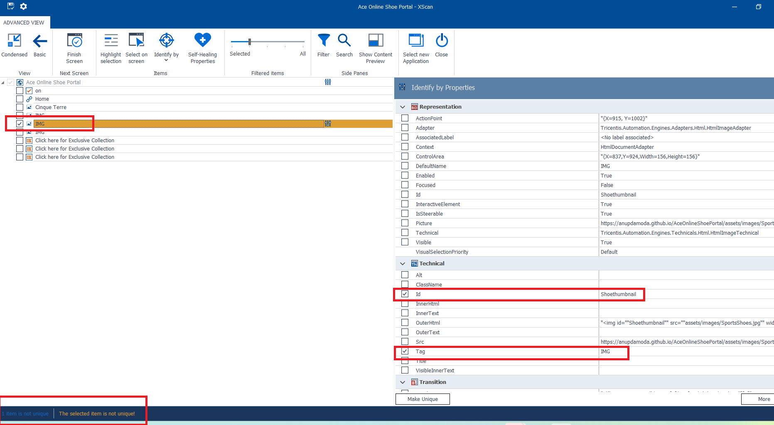
Select second IMG - Identify by Image
Observe the technical properties are not unique.

Slide 27
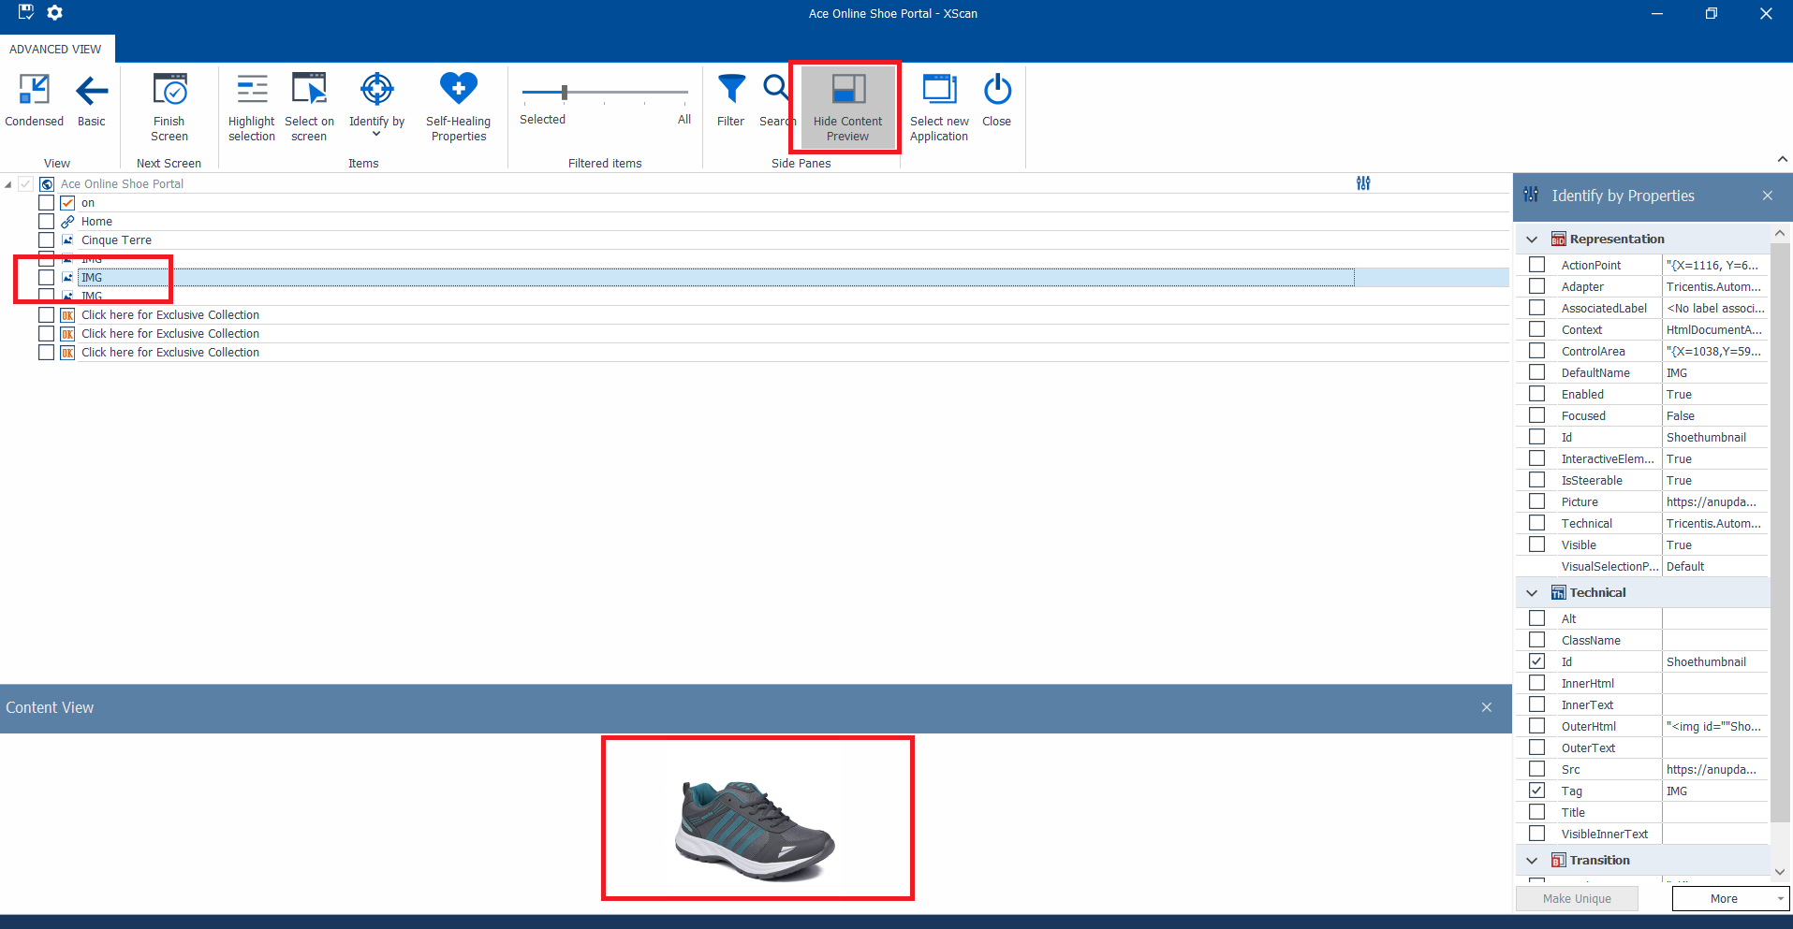
View second IMG - Identify by Image

Slide 28
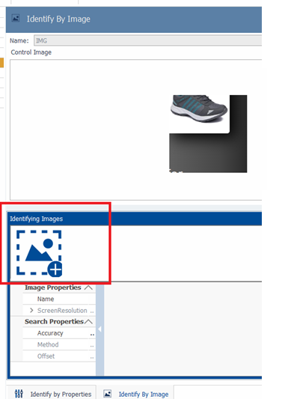
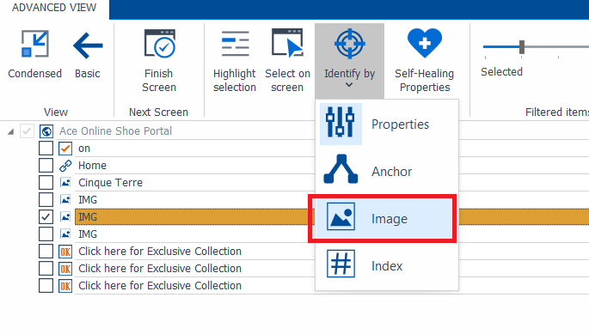
Select Identify by Image

Slide 29
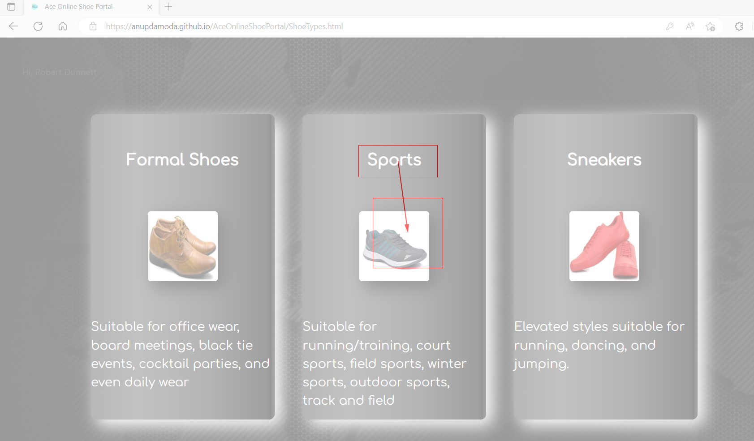
Scan the anchor - Identify by Image
Ensure application is zoomed at 90%.

Slide 30
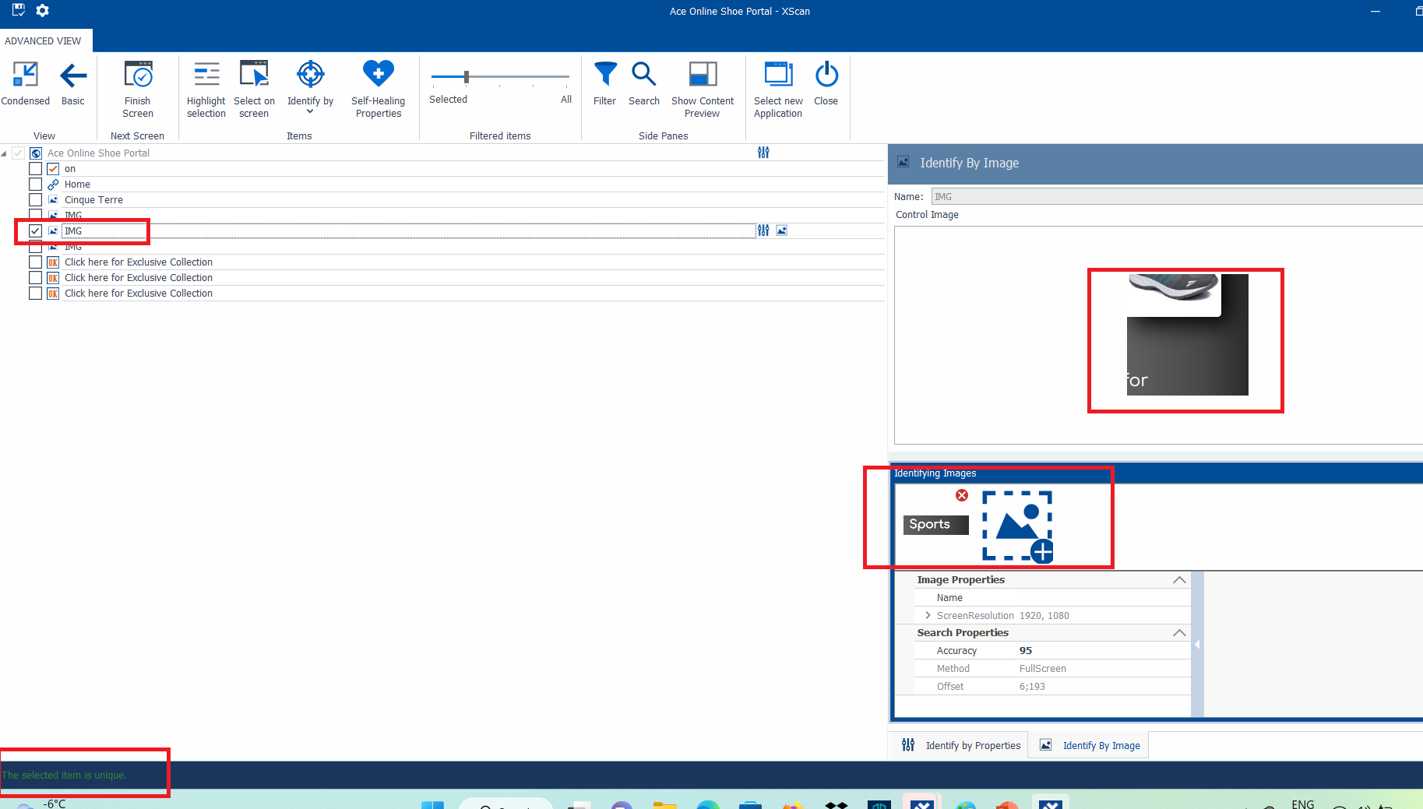
IMG is unique - Identify by Image
Click Finish Screen.

Slide 31
Image Properties - Identify by Image
Screen Resolution should not change. If it changes the image will change.
TOSCA can scan the img 95% accuracy.

Slide 32
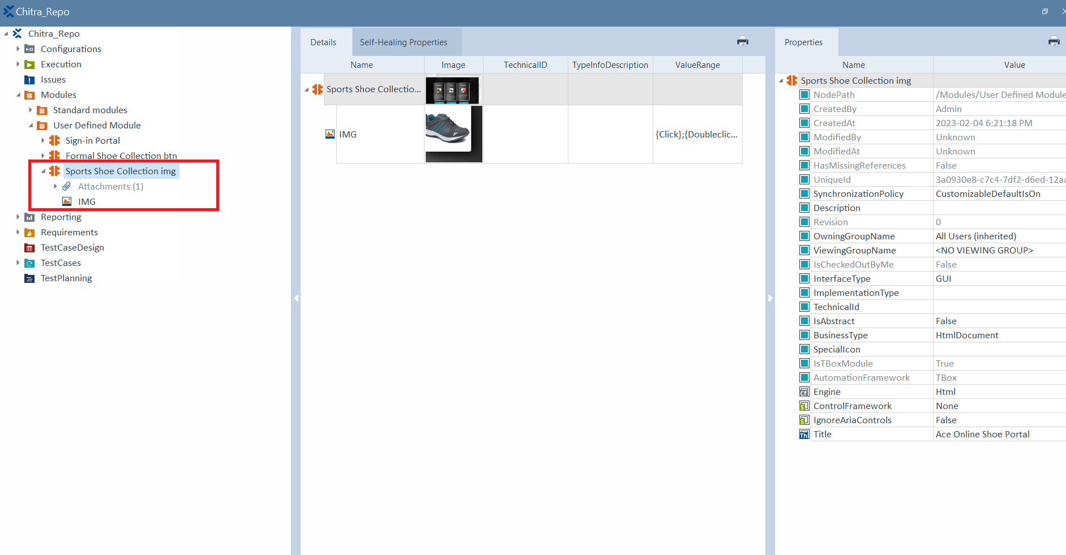
Result - Identify by Image
Rename the new Module.

Slide 33
Thank You

